Slide 1
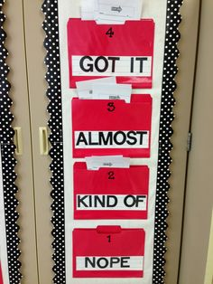
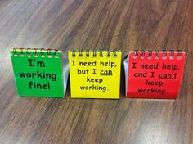
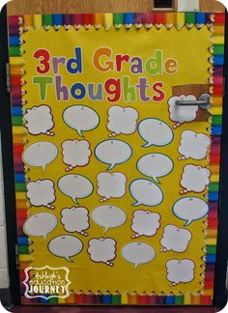
Avoiding Formative Assessment Fizzle?

Slide 2
Formative assessment fizzles when:
The focus of the learning is not on an important understanding or skill

Slide 3
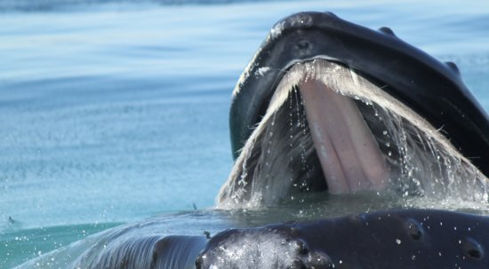
We’re learning to tell the difference between baleen whales & toothed whales

Slide 4
We’re learning how animals have adapted to their environment?
Is today’s learning part of a learning trajectory that leads to important curricular outcomes?

Slide 5
Formative assessment fizzles when:
Teachers try to assess too many different aspects of learning at the one time

Slide 6
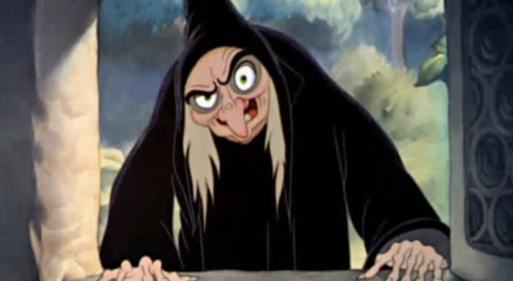
We’re learning to use language to create interesting characters
SUCCESS CRITERIA
I will:
Write more than 5 sentences
Use describing words
Use full stops and capital letters
Use the dictionary to check my spelling

Slide 7
We’re learning to use language to create interesting characters
SUCCESS CRITERIA
I have used powerful words to show what my character:
Looks like
Does
Thinks

Slide 10
Formative assessment fizzles when:
Teachers don’t take the time to fully understand what students know and their misconceptions

Slide 11
Does the yellow shape show ¼?
Thumbs up for yes
Thumbs down for no
Add accountability
Randomly select a student to explain their answer

Slide 12
Does the yellow shape show ¼?
Thumbs up for yes. Thumbs down for no
Randomly select a student to explain their answer
Teacher probes: “What makes you say that?”

Slide 13
Formative assessment sparkles when the focus of the learning is important, and is clear to the teacher and the students.
Should my students be engaging in this learning today?

Slide 14
Formative assessment sparkles when teachers are clear about what should be assessed and what should not be assessed.

Slide 15
Formative assessment sparkles when teachers take time to fully understand students’ thinking.
“What makes you say that?”

