Slide 1
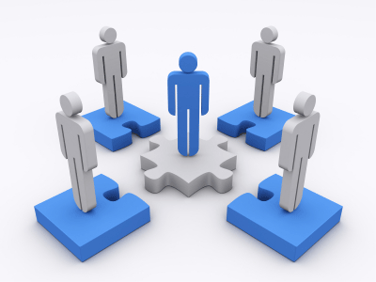
Classroom Discussions: Using maths talk to help students learn

Slide 2
Unpacking formative assessment
Where the learner is going
Where the learner is
How to get there
Engineering effective discussions, tasks, and activities that elicit evidence of learning
Providing feedback that moves learners forward
Teacher
Clarifying, sharing and understanding learning intentions
Peer
Activating students as learning
resources for one another
Learner
Activating students as owners of their own learning

Slide 3
And one big idea
Where the learner is going
Where the learner is
How to get there
Teacher
Using evidence of achievement to adapt what happens in classrooms to meet learner needs
Peer
Learner

Slide 4
Talk can reveal understanding
and misunderstanding.
This helps teachers adjust their teaching. Some people call this formative assessment.
And students may themselves realize what they don't understand and what they do understand.
Notes:
The mathematical thinking of many students is aided by what their peers are thinking.
Putting thoughts into words pushes students to clarify their thinking.
Teachers can spot misunderstandings much more easily when they are revealed in a discussion instead of remaining unspoken.
Researchers have found that few classrooms display consistent or even occasional use of student talk.
Instead, most classroom talk consists of the teacher lecturing, asking students to recite, or posing simple questions with known answers.

Slide 5
As teachers, we have many different academic goals, and many things we want to achieve in our classrooms.
We need as large, diverse and powerful a set of instructional tools as we can find.
Notes:
In this workshop we are going to look at ways of using language that will allow students to engage more fully in mathematical thinking and reasoning.
These include conversational moves that will allow students to engage more fully in mathematical thinking and reasoning.
The goal is not to simply increase the amount of talk in classrooms but to increase the amount of high quality talk in classrooms- productive talk.

Slide 6
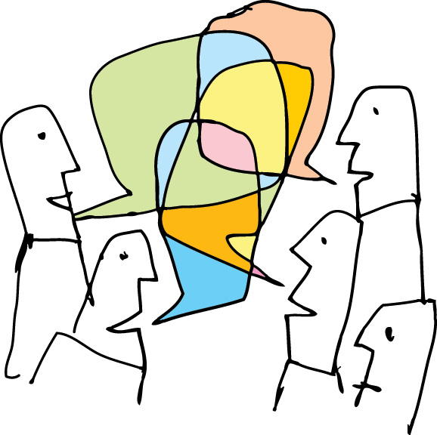
Notes:
Some of your goals may be social.
You may want to get your students to listen to each other respectfully, to cooperate, to build on one anothers ideas.
Some of your goals will be cognitive and social.
You may in a maths class want students to make conjectures, present evidence, voice agreement and disagreement with the claims of others and to support their own positions.

Slide 7
Talk supports robust learning
by boosting memory in several ways.
Talk is a rich source of information, and plays a part in almost every memory we form.
By hearing about (and talking about) concepts, procedures, and uses, our memories have more to work with.
Notes:
All students have a right to engage in Accountable Talk discussions, not just the "best and brightest," nor only those who are struggling in school.
It is not something that should be limited to special times of the day, or to special groups of students.
And we should expect to find Accountable Talk discussions across all grade levels and in all subject areas.

Slide 8
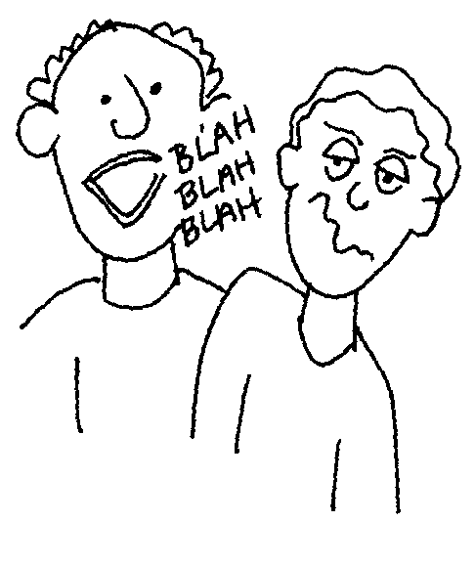
Notes:
We’ve all experienced learning about a concept by listening to a teacher talk about it.
After we listen to the teacher we may feel we understand the concept.
However, when asked to put the concept into words, we may discover that our understanding is not as deep as we thought.
We may become inarticulate, even speechless.
We don’t’ have the understanding to put the ideas into words clearly.
Yet unless we are put into a situation where we MUST talk or write about the concept, we may never come to realise that our knowledge is incomplete, shallow or passive.
How can we push our students beyond incomplete, shallow or passive understanding?
One way is to incorporate student talk into lessons about the ideas they are trying to understand.

Slide 9
Talk supports language development.
When talk is used intensively in classes, students may get a richer sense of what words and phrases mean, and when to use them.
Their control of complex grammar also improves, in speaking and in reading.
Notes:
If a student is going to participate in the discussion, he or she has to be able to share his or her thinking out loud, in a way that is at least partially understandable to others. If only one or two students can do this, you don’t have a discussion, you have a monologue or a dialogue.
If a student is sitting waiting to speak, and is not listening to others, he or she will not be able to contribute to a real discussion. Your ultimate goal involves sharing of ideas, agreements and disagreements, arguments and counter-arguments, not simply a series of students giving their own, unconnected opinions.

Slide 10
Notes:
When we give a student a text to read, we allow them time to read it more than once, to consider the details.
Yet we often forget that when we are talking to the class, presenting new materials, or explaining our words and ideas swiftly pass by.
Student’s can’t call them back and reflect on them to reconsider ideas, pose questions, or work out details.
By carefully using certain talk moves in class we can give students time and space to consider more deeply the content we expect them to learn by allowing them to revisit what was said.

Slide 11
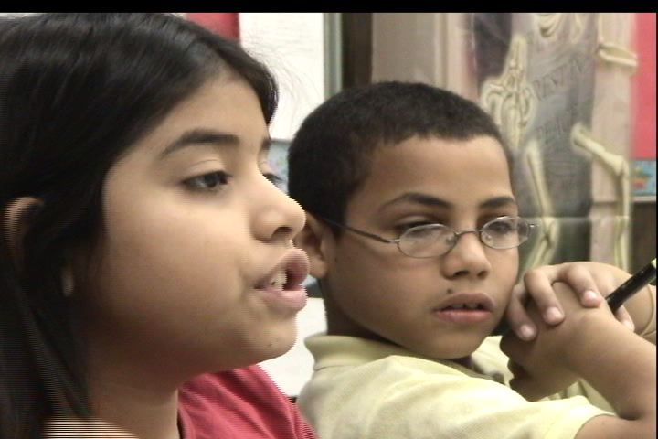
Talk supports deeper reasoning
Learning to reason well takes time.
It takes practice, and it takes working with other people: explaining your own reasoning and talking about other people’s reasoning.
In the classroom, teachers can give students that practice by using talk in strategic ways.
Notes:
After you have gotten students to express their thoughts and listen to others’ ideas, the discussion can still fail if it does not contain attempts at solid reasoning. Some teachers find that their classroom discussions are superficial—students are not working at deeper reasoning. The teacher must scaffold this consistently.
The final step involves students actually taking up the ideas and reasoning of other students, responding to them and working with them. This is when real discussion can take off, discussion that will support robust learning.

Slide 12
Developing Classroom Discourse
What are the talk norms in your classroom?
If someone came into your classroom, what would they hear?
Whose voices would dominate?
If we think of a dialogue as a ball being passed back and forth, who would hold the ball most of the time?
Notes:
Whose voice has the most weight in your class?
How many students speak; how often; and to whom?
Who asks most or all of the questions?
When students talk, how long are their exchanges?
When students talk, how robust and rigorous are their academic explanations, how clear is their reasoning and how well do they “argue” for a perspective?
How do you know what students in your classroom are thinking in a lesson?

Slide 13
How to get students talking!
Why use talk to support maths learning?
What are the barriers to discussions in maths classes?
What are the steps required for productive classroom discussions?
What mathematics should we talk about?
What does productive talk look like and sound like?
Notes:
Why promote communication in math classrooms?
Mathematical thinking of students is aided by hearing what their peers are thinking.
Putting thoughts into words pushes students to clarify their thinking.
Teachers can spot student misunderstandings much more easily when they are revealed in discussion instead of remaining unspoken.
How do we invite students to really attend to the ideas of other students?
How do we use student voices to cultivate the capacity to reason, clarify, question and explain?
What is reflective reasoning?
Listening to encourage other people to talk
Listening to help find out the thoughts and feelings behind what another person is saying
Listening focused on understanding another person’s perspective
Teachers listening to students
Students listening to each other

Slide 14
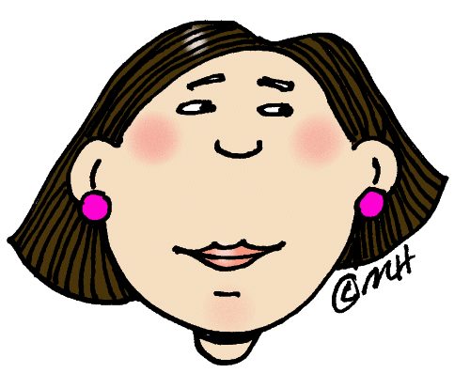
Think of a child…
Quiet in class
Reticent to speak in front of an audience
Lack self confidence
Doesn’t offer an answer readily
Lets others ‘take over’ in group situations
Notes:
What researchers have found…
For many teachers, its not easy to implement in mathematics classrooms.
Few American classrooms display consistent or even occasional use of student talk.
Most classrooms consist of lecturing, asking students to recite, or posing simple questions with known answers.

Slide 15
Findings on classroom talk:
Open questions made up 10% of the questioning exchanges
15% of the sample did not ask any open questions
Probing by the teacher to encourage sustained and extended dialogue occurred in 11% of classes
43% of teachers did not use any such moves
Pupils’ exchanges were very short- 5 seconds on average
Pupil answers were limited to 3 words or less 70% of the time
Notes:
When classrooms are conversational the achievement gains are twice as large
We’ve all experienced learning about a concept by listening to a teacher talk about it. After we listen to the teacher we may feel we understand the concept. However, when asked to put the concept into words, we may discover that our understanding is not as deep as we thought. We may become inarticulate, even speechless. We don’t yet have the understanding to put the idea into words clearly. Yet unless we are put into a situation where we must talk or write about the concept, we may never come to realise that our knowledge is incomplete, shallow or passive.
Getting students to talk about mathematical ideas or concepts can bring to the surface their gaps in understanding.

Slide 16
Positive influences of Using Maths Talk
Talk can reveal understanding and misunderstanding.
Talk supports robust learning by boosting memory.
Talk supports deeper reasoning.
Talk supports language development.
Talk supports the development of social skills.
Notes:
When should students talk and about what?
If we simply ask students to talk, without thinking carefully about our purposes, we may end up with irrelevant talk that serves no clear academic purpose.
We’ve all experienced learning about a concept by listening to a teacher talk about it.
After we listen to the teacher we may feel we understand the concept.
However, when asked to put the concept into words, we may discover that our understanding is not as deep as we thought.
We may become inarticulate, even speechless.
We don’t yet have the understanding necessary to put the idea into words clearly.
Yet, unless we are put in a situation where we must talk or write about the concept, we may never come to realise that our knowledge is incomplete, shallow or passive.
How can we push the learners in our classrooms past passive understanding?
One way is to incorporate student talk into lessons about they idea they are trying to understand.
Certain types of talk may promote specific types of reasoning. For example, discussion either in small groups, or with the whole class can play a critical part in helping students improve their ability to reason logically.

Slide 17
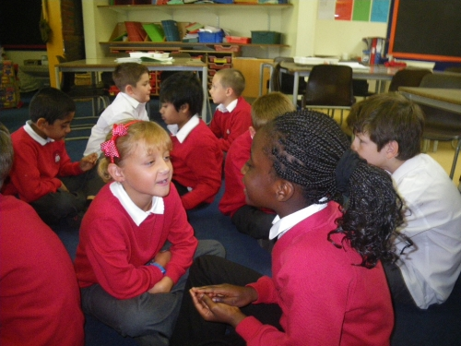
Teacher-student talk
Traditional teacher questioning
Teacher asks a question
Children put up their hands
Teacher takes an answer
Teacher accepts, rejects or develops the answer
Teacher asks a further question
Children’s responses are brief
Teacher steers the answers
What learning takes place?
Notes:
One of the reasons for children’s fear of mathematics is that it is very easy to get something wrong and be told it is wrong without a chance to do anything about it.
When the goal is to hold a discussion in which students can productively share their thinking and work with the reasoning of their classmates, they must be willing and able to listen to what their classmates say and they must try to understand.
We need to provide a structure that supports students hearing what was said and the expectation that all students will try to understand.
Traditionally children only talk in response to teachers questions by putting their hands up and waiting to be chosen.
The time taken up with hands up sessions could be devoted to paired talking.
Learning takes place through dialogue
Argues for a greater emphasis on dialogue talk with extended responses
Teaching through dialogue enables adults and children to build on ideas in sustained talk.
When teaching through dialogue, teachers encourage children to listen to each other, share ideas and consider alternatives; to build on their own and others 'ideas to develop coherent thinking; to express their views fully; and to help each other reach common understanding.

Slide 18
4 Big Ideas
You have to make what everyone says and what you say understandable.
Notes:
In classrooms we are aiming to get students to think systematically. We want them to listen to their own and to other peoples thinking. It’s very useful for students to be engaged in talk as they’re trying to learn. Look at the Japanese schools. We are aiming to get students to use classroom talk in ways that are more robust than rote memorisation. We need to ensure classroom talk is used for teaching understanding. Is teaching with talk difficult? Yes, it is.
Here’s the thing. Teachers have to do at least four different things at the same time.
Deal with noisy, messy classrooms even in the best of circumstances. You have 30 brains all listening to all things and thinking different things in their heads.
So the first task is to make what everyone says and what you say understandable. If using talk to promote understanding and you ask a student a question and they say something; the chances are very great that you won’t understand because half of the time students are unclear and probably less than half the time teachers are unclear.
It’s difficult to understand other people so throughout most of our day we deal with lunch, sport, and going to the supermarket and we can easily understand those things but if we are talking about operations on fractions it’s really hard to understand what someone is saying. Most people are not going to understand it the first time around.

Slide 19
4 Big Ideas
You have to make what everyone says and what you say understandable.
You have to manage coherence.
Notes:
You have to manage coherence. That’s number two.
So you’re not teaching a lesson about isolated facts. You’re trying to convey a certain logic. Even if you’re just reading a book to twenty kinders there’s a logic to what you are trying to do.
So, how do you maintain coherence? How do you maintain coherence when you’ve got all the little people thinking in different ways? If you are using talk to promote learning it’s easy to get off track. People make their contributions and their contributions don’t exactly fit in with your narrative. So what do you do with that? Do you just leave them by the side of the road? Then you have other problems.

Slide 20
4 Big Ideas
You have to make what everyone says and what you say understandable.
You have to manage coherence.
You have to be able to develop and maintain student support with student engagement and motivation.
Notes:
Then the third thing is you have to be able to develop and maintain student support with student engagement and motivation.
Student engagement is more than just sitting and listening. It’s “I want to think about this and I want to be part of this discussion” and that’s very hard but you do that all the time in the role of teacher.
Using talk in skilful ways to promote engagement and motivation

Slide 21
4 Big Ideas
You have to make what everyone says and what you say understandable.
You have to manage coherence.
You have to be able to develop and maintain student support with student engagement and motivation.
You have to be managing equitable participation.
Notes:
Then fourth you have to be managing equitable participation.
This is not an easy thing. So when you use talk in a classroom there’s always a temptation to rely on the one, two or three children who are most comfortable talking and are willing to tell you their opinions about everything. They can engage with you in a one to one conversation. It’s a real temptation to work with these kids because it’s so much easier.
What happens if you do do that is that you’re not really committed to having everyone participate. Students are very quick to see “Oh, I don’t have to do this. He’s the one the teacher always talks to so I’ll just sit back.”
“I don’t have to do this” and they just opt out so from the very beginning you must demonstrate that you are committed to having everyone participate in an equitable way.
Everybody gets heard. Everybody gets their ideas taken seriously.
We don’t always rely on the wonderful, brilliant, funny John but we all slog through this together.
Unless you classroom conversations do this you won’t:
Manage intelligibility
Manage coherence
Keep everyone engaged and motivated
Have equal participation
So what are skilled teachers who can do this actually doing?

Slide 22
Talk Formats
Different ways teachers configure classrooms for discussions
Whole group – provide students with practice reasoning opportunities
Small group – provides opportunity for more loosely directed conversation.
Partner – provides an opportunity for students who may have difficulty speaking up.
Notes:
You think about conversation as being a bit like a game of chess. He said and then I responded in this way and then he said and then I responded and so it’s sort of like moves in a chess game.
When you’re a teacher you’re actually thinking like so Fred said this. How should I respond?
What’s my move? What’s my response? How can I answer that back in a way that will position me for what I want to do next?
So when we call them talk moves it’s just kind of a way of saying this is a strategic thing that you do and there’s certain classes of these actions that you take…these conversational actions.
A study in the 90’s of teachers who were particularly successful in getting students talking in classrooms.
We looked for recurrent talk moves. Things that they did that engaged those students and pushed them towards reasoning.
The study identified a lot of talk moves that these teachers used and they are going to be familiar to all of you.
There’s nothing special about them. We just put them in one place and thought about how they could be used.
How do these talk moves support teachers and learners in busy classrooms?
One of the things I recognise is that classrooms are incredibly difficult. They’re complicated. They’re messy. You as the teacher have this incredibly difficult job of keeping things intelligible.
Keeping the content coherent. Making progress with the content. Keeping everybody engaged. Keeping everyone motivated. Making sure everyone gets to participate. All at the same time.

Slide 23
Productive Talk Moves
Revoicing: ( by the teacher) a student’s contribution
Repeating: Asking students to re-state another student’s contribution
Reasoning: Asking students to apply their own reasoning to someone else’s reasoning
Adding On: Prompting students for further participation
Waiting: Using wait time
Notes:
This framework is known as the Five Productive Talk Moves
The five moves are:
Re-voicing – Teacher repeats some or all of what the student has said. Students verify what was said.
Asking students to restate someone else’s reasoning – “Can you repeat what he just said in your own words?”
Asking students to apply their own reasoning to someone else’s reasoning – “Do you agree or disagree and why?”
Prompting students for further participation – “Would someone like to add on?”
Using wait time (10 seconds)
Dialogue requires a climate where it is safe for learners both adult and student to come up with ideas which may be incomplete or way out, to think out loud, to explain their reasoning and illuminate their misconceptions and to explore their understandings
Though I first thought about the talk moves in the context of teaching math, I feel they are appropriate in all content area instruction and worth adding to your inventory of phrases and expressions you use to elicit responses from students.
With talk moves students have a chance to be engaged in sustained reasoning.
The teacher’s role is to guide and facilitate-but does not focus on providing answers directly.
Instead the focus is on the student’s mathematical thinking-which will lead to mathematical discoveries and conjecture of maths concepts that will be more deeply understood and remembered.
What is so hard about increasing student discourse however are teacher habits, beliefs and pressures as well as student habits, beliefs and history

Slide 24
Revoicing
Clearing confusion with the correct math language.
This is about a students contribution
Elaboration, increase clarity of reasoning
Bridge to more mathematical reasoning
Set up alignments and oppositions
Demonstrate attention and concern for student thinking and voice
“So you’re saying you added 3 tens plus 4 tens and got 7 tens?”
“So, you’re saying it’s an even number. Is that what you mean?”
Notes:
Revoicing (asking the student to verify your interpretation and clarify his or her thoughts)
These are all familiar. Start thinking about talk moves from the point of view of “What do you do when someone says something and you don’t understand?” One of the most useful ones is the revoicing move. It usually starts with …sooooooo? Then they repeat something that the student has said. Then they ask the student “Is that right?” That’s crucial. It’s not just repeating what the student has said. You repeat all the time when you are a teacher.
Revoicing is actually a move that has a third part. They say something. You say so….I infer that you are thinking this? Is that right? Or “I infer that you are saying…..the same thing as she said?” “Is that right?” or “I think” or “I’m hearing you say that such and such….is that right?”
Let’s look at the example called revoicing.
Well, the teacher repeat part or all of what the student said and asks the student to verify whether her interpretation is correct. So, here’s an example. The student says……The teacher says so you’re saying that…..just checking with them.
It’s a very simple move. Well, you might look at that and say so what. What does that do for teachers and for learners. I’m going to give you three examples of three different ways this can be used.
What? This is where the kids say something and you think…what? Head shake. Pardon me?
In my experience at least 50% of what students say in classrooms is unintelligible. You can’t figureout what they mean. Some teachers have argued that 50% is too low but nobody has ever said that it’s too high.
It is important to help students get better at saying what they are thinking in ways that can be understood.
Very often, students say things that are difficult to understand.
So we need to provide supports for them to express their thoughts and to use mathematical language.
Press for reasoning…ask students to explain their reasoning.
All students must get used to explaining why they say what they say.
Why do you say that? What convinced you that was the answer?
What makes you think that?
How did you get that answer?
This talk allows teachers to interact with a student who is unclear.
The teachers tries to repeat some or all of what the student has said.
Then the teacher asks the student to respond and verify whether or not the revoicing is correct.
You will need to repeat or rephrase but then also ask the student if this is the correct interpretation of what he or she was trying to say.
Few students will improve if teachers only call on the clear students.
This move can also be effective when the teacher understands what a student has said but is not sure that the other students in the class understand.

Slide 25
Revoicing: What is it?
T: So is the sum going to be positive or negative?
S: Well, the thingy is over that way, so it’s positive.
T: OK, so are you saying that our arrow is going to the right, past the zero, so it’ll be positive? Is that what you’re saying?
S: Yeah.
The teacher notes that the student is saying or thinking something, repeats part or all of a student's utterance, and asks the student to verify whether her interpretation is correct. Some people call this verify and clarify.
Notes:
So, here’s an example. The student says……The teacher says so you’re saying that…..just checking with them.
OBSTACLE: Often a student says something that is completely unclear. Very often.
Many teachers feel uncomfortable asking the student to clarify, because they don't want to put the student on the spot.
This is where the kids say something and you think…what? Head shake. Pardon me?
In my experience at least 50% of what students say in classrooms is unintelligible. You can’t figure out what they mean. Some teachers have argued that 50% is too low but nobody has ever said that it’s too high.
It is important to help students get better at saying what they are thinking in ways that can be understood.
Very often, students say things that are difficult to understand.
So we need to provide supports for them to express their thoughts and to use mathematical language.
Press for reasoning…ask students to explain their reasoning.
Some teachers don't want to look like an idiot if they still can't understand the student after the student tries to clarify.
So they just move on… and lose the chance for formative assessment.
Revoicing gives a way to deal with this.

Slide 26
Looks like/ Sounds Like
In a whole group discussion a class discusses if 24 is an even or odd number.
Philip: “Well, if we could use three, then it could go into that, but three is odd. So then if it was…but…three is even. I mean odd. So, if it’s odd, then it’s not even.
Teacher: Ok, let me see if I understand. So you’re saying that 24 is an odd number?
Philip: “Yeah. Because three goes into it, because 24 divided by 3 is 8.
Notes:
The teacher is confused about the student’s comments and asks the question back of the student to see if her understanding is correct.
This gives the student a chance to clarify.
This also gives the teacher a chance to see if the student has a misconception or an understanding of the concept.
When students talk about mathematics it’s often difficult to understand what they say.
Even if their reasoning is sound, it may not appear sound when they try to put their thoughts into words.
Sometimes it’s impossible to ell whether what they have said makes sense at all.
And if you as the teacher have trouble understanding it, there’s not much hope that the student’s classmates will do any better.
Yet given your goal is to improve the mathematical thinking and reasoning of all students, you cannot give up on an especially unclear student.
If the only students whose contributions are taken seriously are those who are easy to understand, few students will ever improve.
Deep thinking and powerful reasoning do not always correlate with clear verbal expression.
While revoicing is useful as in situations like Philip, it’s also an effective move when you understand what a student has said but aren’t sure that the others in the class understand. Revoicing can make one student’s idea available to others, give them time to hear it, position a student’s claim with respect to a previous student’s claim in order to create the basis for an ongoing discussion, or focus on a change that has occurred in the discussion.
Revoicing provides more thinking space and can help all students track what is going on mathematically.

Slide 27
What is happening here?
The teacher is confused at first, but then gets a clearer sense of what the student understands and doesn’t understand.
The student realises that the teacher wants to understand her contribution. Over time this can have a profound effect.
The student can either accept or reject the teacher’s interpretation , which positions the student as a legitimate participant in the intellectual enterprise.
(Confusion about what students have said is an extremely common-and sometimes embarrassing- state of affairs)
Notes:
You see students who no one has ever struggled to get them to say clearly what they mean and has said ok we are going to take the time that it takes until I understand you
When that student is given a chance to follow up.
That student is more a legitimate participant in the intellectual conversation in the classroom.
Ok, so here’s another example.

Slide 28
Revoicing
“I want everyone to hear that!”
Notes:
This is a very different example.
Here the teacher does not have a problem understanding.
She has understood what the student has said.
And she wants to use it because it’s great.

Slide 29
Teacher: So you are saying you took um….each lamington….

Slide 30
Teacher: Like this was one of your lamingtons…and you split this into quarters?
Notes:
And she starts writing it up on the board. Using it as an example.
But’s she’s asking it as a question. She’s asking …is that what you meant?

Slide 31
Girl: Yeah, and uh, like we labelled each person…..
Notes:
What’s happening here? The teacher is using these students work to ensure a more coherent lesson.
All the students get a chance to hear a clear version of the reasoning of their peers.
By rebroadcasting it she’s making it really evident that this is important.
Everyone can hear this. The original student…..
Gets the chance to expand on their ideas in public

Slide 32
One more example
Bringing out the greater significance

Slide 33
Teacher: So what you’re telling me is that the definition ….of the variable…is a very important…idea in mathematics?
Notes:
Same move, different function
Teacher: So what you’re telling me is that the definition ….of the variable…is a very important…idea in mathematics?
This is maths class and the teacher says : So blah, blah, blah
Now that is not what the student said.
They said something sort of ahhhhhh about the variable
The teacher has taken the opportunity to say so this is what the higher significance of your contribution is

Slide 34
Student: Yeah
Notes:
And the teacher reframes it again

Slide 35
Teacher: Ok, it makes a whole difference of …what the expression means?

Slide 36
Student: Yeah, it means that….

Slide 37
What is happening here?
The teacher gets a chance to inject higher level vocabulary or ideas into the discussion while still maintaining contact with student ideas.
The student gets to make the connection between what he said and this higher order formulation. Other students hear this too.
The student gets credit-shares in this higher level version of what he said.
Notes:
The student sort of gets credit for the fancier version.
Yes, that is what I said.
Over time as they share in that higher level of discussion about what they’ve said they begin to take it on.
Ok, so when teachers start to use this revoicing move , again….so are you saying…
Blah, blah, blah, blah…is that what you said? It’s really pretty simple.

Slide 38
When teachers begin to use this move they gain:
Time to think
Ways to interact without embarrassment
Insight into student thinking and knowledge
Notes:
Time to think: This is huge. When you are having a discussion and we are saying things…I don’t know about you…but I’m thinking..I’m lost..you’re going too fast..I can’t understand….it gives you time to stop and think and get your ground a little bit
Embarrassment: So if you totally don’t understand but can just hear a word or two
So you’re saying….what was that again?
Can you fill in the blank? Can you help me? That’s revoicing.
It’s not embarrassing.
They realise you want to understand.
Insight: It also gives you insight
And so many teachers say when they start to use revoicing
That they didn’t realise their students had much better ideas than they thought
Well, he never got a chance to talk before
So if you really insist on people talking and listen to what they say you will hear their thinking

Slide 39
So once the students are externalizing their reasoning, sharing their thinking out loud, how do you get other students to orient to that reasoning, to listen to it?

Slide 40
Restating
Asking students to restate someone else’s reasoning.
This will:
Build a community of active listeners
Provide another phrasing of reasoning for students to engage with
Formative assessment
”Can you repeat what he just said in your own words.”
Notes:
This is another move. We call it “Can anyone repeat what he just said?
You put it in your own words
Once you’ve got an idea out there and you want to make sure everyone has heard it and everyone is listening you can say “Ok, can you repeat what she just said or can you put it in your own words?”
This is another move. We call it “Can anyone repeat what he just said?
You put it in your own words
That is a little bit more challenging than just a question “Do you understand?” because I can understand something “Oh, yeah, I understand.” “Well, could you repeat it?” “Uh, no”. Why? ……because that takes another step.
You have to reformulate it. Put it in your own words or try to remember their words.
The demand that gets brought into the classroom when you use that move “Can you repeat what she just said? Can you put it in your own words?”
The demand that gets brought in is extremely useful because everyone in the room is on call.
When you say to other students “Can you repeat what he just said that is a big shift for a lot of them. When you do this move the first time they are going to look at you like “What!”
You want me to what? We’re going to talk about how do you start that process of we’re going to be using talk in these ways so we can be sure we all understand each other
Having a peer repeat what you say is a very powerful experience for a lot of kids
You can tell by just watching them. Having someone put in their own words what they just said
Brings up their interest and engagement automatically
Because someone is listening to them
Hearing it again is important. So many students not just English language learners but everybody needs to hear things more than once
I need to hear things more than once
I’m highly educated. I’m a grown up.
But I need to hear them more than once…so when you have students say things again in a different words it has that processing effect…everyone can process it better….everyone can remember it better….so if you’re talking about words every time someone restates a word or a thought or an idea they are using those words and they are talking about them
And they’re talking about the ideas and you’re hearing it again
When you have to put someone else’s words into your own it forces you to think about it. It brings you out of your little box of just thinking about your own ideas.
It gets you to think about what they said.
It gets students to listen to each other. So the conversation is not just teacher, student, teacher
Value the importance of what others have said.
Over time it does change the culture of the classroom
How do you get this to happen.
This is the one where if you ask a student can you repeat what she just said
And the student says “no”
Well, why not?
I didn’t hear her.
How do you get children to feel obligated to care what everybody says and to listen
The reciprocal obligation of each student is to talk loud enough so that everyone can hear them
That’s another one
So this is a very powerful culture changer
Once you’ve got an idea out there and you want to make sure everyone has heard it and everyone is listening you can say “Ok, can you repeat what she just said or can you put it in your own words?” That is a little bit more challenging than just a question “Do you understand?” because I can understand something “Oh, yeah, I understand.” “Well, could you repeat it?” “ Uh, no”. Why? Because that takes another step. You have to reformulate it. Put it in your own words or try to remember their words. The demand that gets brought into the classroom when you use that move “Can you repeat what she just said? Can you put it in your own words?” The demand that gets brought in is extremely useful because everyone in the room is on call. They have to listen. It’s not that easy. You really have to change the way that you are listening. Once you change that….once you know that the teaching might just pick on you and call you out and say “Can you repeat that?” It changes the level at which people listen.
This talk move extends the responsibility to the students in the classroom. It helps to orient students to others thinking.
If others in the class were not paying attention or if they did not hear what was said this talk move brings them back to the conversation
This is not meant as a management move to “catch someone out”. Kids are allowed to say “ I didn’t hear” or “ I didn’t understand” but they must then ask the other student to repeat his or her point and then you must follow up by asking them to repeat it.
By asking one student to restate or rephrase what another student has said, it requires the class to listen to each other and make sense of ideas shared.
After the student has restated, go immediately back to the original student for follow up.
This move allows the rest of the class to hear the idea shared one more time so they have more time to process what was shared.
This move quickly puts students on notice that they must listen to their classmates contributions and cannot simply sit and wait for their turn. They must actively engage in trying to understand what others are saying.
They have to listen. It’s not that easy. You really have to change the way that you are listening.
Once you change that….once you know that the teaching might just pick on you and call you out and say “Can you repeat that?” It changes the level at which people listen.
This talk move extends the responsibility to the students in the classroom. It helps to orient students to others thinking.

Slide 41
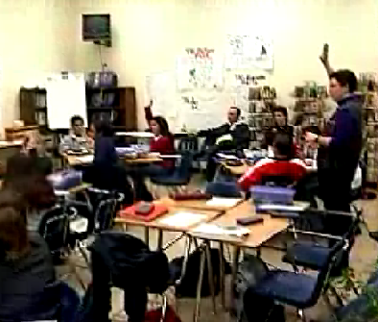
Teacher: Put your hand up if you understand what she just said?
Notes:
As you work on deepening and clarifying one student’s reasoning, other students need to be following along. Even if the speaker is mathematically correct and precise, that does not mean that everyone will follow it. Many students will tune out when they hears a classmate produce a long and complex piece of reasoning. This is an ideal time to use the “Who can repeat?” move and ask for volunteers to put the students reasoning into their own words.
If others in the class were not paying attention or if they did not hear what was said this talk move brings them back to the conversation
This is not meant as a management move to “catch someone out”. Kids are allowed to say “ I didn’t hear” or “ I didn’t understand” but they must then ask the other student to repeat his or her point and then you must follow up by asking them to repeat it.

Slide 42
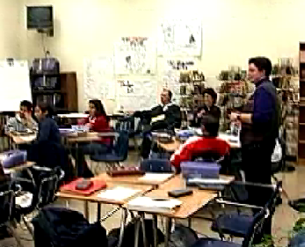
Teacher: OK, keep your hand up if you think you can repeat what she said.
Notes:
Who can put this in their own words? Sometimes students are not able to answer a question.
What do we do? Perhaps we adopt “who can repeat” as a routine so that when a student is confused or unable to answer a question for any reason, he or she simply asks for someone to repeat the question, repeat the answer or repeat some information.
This is not looked upon in a negative way; it is simply one of the classroom routines that allow everyone to get some form of support when needed.
The important mathematical idea is put out into the public arena where students can hear it again. Remember that it is important for the teacher to immediately return to the student after he has listened to the explanation and ask him to repeat what was said.
When students know that their teacher will always return to them after a similar exchange they really concentrate and work hard to understand the material.
Asking students to repeat what another has said has several benefits. It lets all students know that they are responsible for listening to and understanding other student’s ideas. It allows all students to hear the solution strategy more than once, and it keeps the discussion going since it gives everyone time to reflect on what is being said.

Slide 43
Looks like/ Sounds like
Teacher: “Can anyone repeat what Philip just said in his or her own words? Anne?”
Anne: “Um, I think I can. I think he said that 24 is odd because it can be divided by 3.”
Teacher: “Is that right, Philip? Is that what you said?”
Philip: “Yes.”
Notes:
If other students could not or did not hear what a speaker said, they cannot easily participate in further exchanges.
Over time, as students come to realise that people are listening closely to what they say, they increasingly make efforts to make their contributions comprehensible.
Who can restate what Phillip just said? You can also ask the original speaker whether the new rendition of his/ her contribution are in fact what he/ she intended to say. “Phillip, is that what you intended to say?”
Who can repeat? When a student says something potentially important you may want to capitalise on it. But if other students did not hear it, or were not paying attention, they will not be able to take the next step and think about it.
It’s important to note that this is not being used as a management move. It’s important to get across to students that they are allowed to say I didn’t hear” or “ I didn’t understand” but they must then ask the first student to repeat his or her point, and then you must follow it up by asking them to repeat it.
Press for reasoning (asking students to explain their reasoning)
To deepen the focus on shared reasoning, all students must get used to explaining why they are saying what they say.

Slide 44
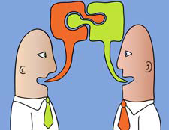
Restate
Lets listeners know:
that you are listening,
that you are trying to understand them,
that you care about their thoughts.
Notes:
Paraphrasing is not just repeating ...
By asking one student to restate or rephrase what another student has said, it requires the class to listen to each other and make sense of ideas shared.
After the student has restated, go immediately back to the original student for follow up.
This move allows the rest of the class to hear the idea shared one more time so they have more time to process what was shared.

Slide 45
Restate
Restating is more than just repeating ...
When you listen to Harry’s ideas what comes into your mind from your own experience?
What you say about ... is very interesting. Can you elaborate on it?
Sue tells us … and that is very like what Tom said when he described … Is that right Sue and Tom?
Notes:
When the teacher uses “who can repeat?” or “who can put that in their own words?” it serves to get everyone on the same page, to focus attention and make sure everyone gets another chance to hear.
These all serve the goal:
. Helping students to orient to others and listen to what others say.

Slide 46
Agree/ Disagree….Why?
Asking students to apply their own reasoning to someone else’s reasoning.
This will:
Encourage students to engage with one another’s ideas
Direction attention to reasoning rather than answers
Make mathematical connections
Promote community argumentation and justification
“Do you agree or disagree and why?”
“How is Joel’s thinking similar to or different than Michelle’s?
Notes:
Another important move is “Do you agree or disagree?”
This is one where when someone has made a claim you can ask someone “Do you agree with that? Do you disagree and why?” It’s important to add the why. So we could separate that into two moves.
You use all these moves in a flexible and strategic way.
The why brings out “What’s your thinking about this?”
It’s also another way of controlling attention because if you ask someone if they agree or disagree they have to have heard and understood what that person said.
After everyone hears and understands the claim, and the reasoning behind it, they are ready to take the step of really engaging with the idea. Often teachers simply ask for “thumbs up/ down” if you agree/disagree.
It is crucial to follow up with the question “Why do you agree/ disagree?
Otherwise, students provide generic answers without really thinking through their position.
The why brings out “What’s your thinking about this?”
It’s also another way of controlling attention because if you ask someone if they agree or disagree they have to have heard and understood what that person said.
“Who has a similar/ different idea about how this works?” “Does that make sense to you? Why does it make sense?”
When you ask students to agree or disagree with what another student said it’s helpful to emphasise that the agreement or disagreement is with the idea or the mathematics not about the speaker.
What does this do for you and your kids? The pros of this are pretty obvious
You start to build that community of talk and people are listening to each other
And you get more of the student thinking out
Do you see any downsides to this one?
Sometimes it takes a little while and you have to be patient.
You have to listen and value what is said
Traditionally it becomes very ping pong and you get those very low level responses back from kids and you’re on to the next thing…this is more co constructing knowledge together
And it’s deepening the level of concept development for individual students and the whole class because if I have to tell you why I disagree or why I agree then I’m building on my knowledge base as well as someone elses
So this is not just do you agree or disagree and we’ll go on now
It’s why and when you ask a student who’s not really listening and not really thingking
Do you agree with what he just said?
Uh-huh
Why do you agree?
What do you mean? Why do I agree?
Uh. I just agree.
Well, tell us in your own words why you agree.
How do you think about it? What is your thinking about this have to do with what he just said?
You can really probe student thinking.
So the why is important
Some teachers when we start using this just say….does everybody agree?
Smile and nod.
Kids say uh huh and move on.
Well, that’s not what this is.
This is exploring student thinking so it takes time and you’ve got to be patient
Pairing, writing about it, small groups.
So it’s not always just going back and forth between the teacher and the student
Partner talk…turn and talk…do you agree or disagree
Tell them
You might talk about the WHY move as a separate move because you’re not going to be using it with the “Do you agree/ disagree?” but you are always going to be pressing for reasoning. Why do you think that?’ What’s your evidence for that?
Where does it say that in the text?
How did you come up with that?
What method did you use?
Talk us through your reasoning.
There’s a million ways to say it but it’s all towards the same end. You have some thinking. You have some reasoning. Explain it to us. Expand. Open it up. So…pressing for reasoning.
This move encourages students to apply their own reasoning to someone else’s reasoning.
The teacher should not support one position or another but should use the talk move to elicit other ideas.
This talk moves gets students to listen critically to the reasoning of their peers.
Often teachers simply ask for thumbs up if you agree, thumbs down if you disagree. This is a start but it is not going to get students to deeply engage with others reasoning. It is crucial that the teacher follow up with “Why do you agree/ disagree?”
Who has a similar idea or a different idea? Does that make sense to you? Why does it make sense?
It is critical that students support their decision by explaining their math reasoning as it supports students’ mathematical learning.
When you ask students to agree or disagree with what another student said it’s helpful to emphasise that the agreement or disagreement is about the IDEA or about the MATHEMATICS not about the SPEAKER

Slide 47
Looks like/ Sounds like
Teacher: “Anne, do you agree or disagree with what Philip said?”
Anne: “Well, I sort of ….like…I disagree.”
Teacher: “Can you tell us why you disagree with what he said? What’s your reasoning?”
Anne: “Because I thought that we said yesterday that you could divide even numbers by two. And I think you can divide 24 by two. And it’s 12. So, isn’t that even?”
Notes:
You use all these moves in a flexible and strategic way.
What does this do for you and your kids? The pros of this are pretty obvious
You start to build that community of talk and people are listening to each other
And you get more of the student thinking out
One powerful effect of using this move consistently: students start to spontaneously give their reasoning.
Do you see any downsides to this one?
Sometimes it takes a little while and you have to be patient.
You have to listen and value what is said
Traditionally it becomes very ping pong and you get those very low level responses back from kids and you’re on to the next thing…this is more co constructing knowledge together

Slide 48
Troubleshooting
Question:
What if a student I call on can’t repeat or rephrase what another student has said? Or what if they refuse to?
Answer:
You can make it clear that it’s perfectly fine to not be able to repeat or rephrase, but if a student who is called on didn’t hear or didn’t understand or can’t repeat, they need to ask the original student to say it again.

Slide 49
Troubleshooting
Question:
What if a student repeats or rephrases what another student has said, but they get it wrong? Should I correct that or ignore it or what?
Answer:
When you’re talking about complicated ideas, it’s easy to misunderstand what someone has intended. You shouldn’t be afraid to check back with the original speaker and ask “Is that what you meant? Did we understand you correctly?” Over time, this will help students become more resilient communicators.

Slide 50
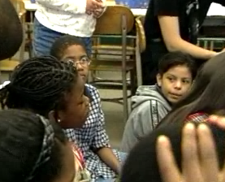
Well, I agree with what Steve said, because he said that like, he said that um, if you changed the four, it wouldn't really be seven fourths.
Agree or Disagree? Why?
Notes:
And it’s deepening the level of concept development for individual students and the whole class because if I have to tell you why I disagree or why I agree then I’m building on my knowledge base as well as someone else’s
So this is not just do you agree or disagree and we’ll go on now
It’s why and when you ask a student who’s not really listening and not really thinking
Do you agree with what he just said?
Uh-huh
Why do you agree?
What do you mean? Why do I agree?
Uh. I just agree.
Well, tell us in your own words why you agree.
How do you think about it? What is your thinking about this have to do with what he just said?

Slide 51
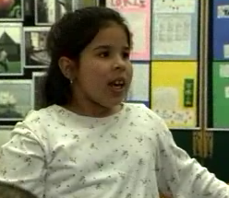
Well, I agree with him, like, um,
but I disagree with Lon…
Notes:
You can really probe student thinking.
So the why is important.
Some teachers when we start using this just say….does everybody agree?
Smile and nod.
Kids say “uh huh” and move on.
Well, that’s not what this is.
This is exploring student thinking so it takes time and you’ve got to be patient
So it’s not always just going back and forth between the teacher and the student
Partner talk…turn and talk…do you agree or disagree
Why do you think that?

Slide 52
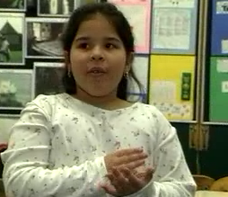
because he said..
because, um, if it was just four parts?
Notes:
You might talk about the WHY move as a separate move because you’re not always going to be using it with the “Do you agree/ disagree?” but you are always going to be pressing for reasoning. Why do you think that?’ What’s your evidence for that?
Where does it say that in the text?
How did you come up with that?
What method did you use?
Talk us through your reasoning.
There’s a million ways to say it but it’s all towards the same end. You have some thinking. You have some reasoning. Explain it to us. Expand. Open it up. So…pressing for reasoning.

Slide 53
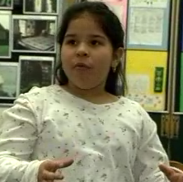
you could cut one really small,
and one really big.
Notes:
An important reminder: If you just ask for agreement or disagreement, without asking why the student agrees or disagrees, students can 'phone it in' without really paying attention to what the first student said. "Oh yeah, I agree. Uh huh."
This move encourages students to apply their own reasoning to someone else’s reasoning.
The teacher should not support one position or another but should use the talk move to elicit other ideas.
This talk moves gets students to listen critically to the reasoning of their peers.
Often teachers simply ask for thumbs up if you agree, thumbs down if you disagree. This is a start but it is not going to get students to deeply engage with others reasoning. It is crucial that the teacher follow up with “Why do you agree/ disagree?”
Who has a similar idea or a different idea? Does that make sense to you? Why does it make sense?
It is critical that students support their decision by explaining their math reasoning as it supports students’ mathematical learning.
When you ask students to agree or disagree with what another student said it’s helpful to emphasise that the agreement or disagreement is about the IDEA or about the MATHEMATICS not about the SPEAKER

Slide 54
Add on / Say more
Prompting for further participation will:
Increase opportunities for participation from a variety of students
Get multiple solutions/ ideas on the table
Push to deeper levels of mathematical thinking
”Would someone like to add on or share another method?”
“Who can add an idea to this discussion?”
“Who can say more?
Can you give us an example?”
Notes:
Can you say more?
So simple and kind of dumb but extremely useful. Say more. Can you add on? You can ask other students “ Can you say more? Can you add on to what she just said?”
They love to do that because it gives them a little platform. It gives a feeling of security. “Yes, I can add on. I can add this little piece.” So “Can you add on or can you say more?”
Can you give an example or a counter example?
This is particularly useful in mathematics.
“Can you give an example of that?” is one way to get people to expand in a very substantive way. You can ask other students “Can you give an example of what she just said?”
So if we all understand what we are talking about you should be able to exemplify it, right?
So the counter example is very useful in mathematics.
This move increases participation by asking other students to either agree or disagree or to add other comments.
This prompting for more input on previous statements will, over time, result in students showing more willingness to weigh in on what the group is considering.

Slide 55
Can you say more?
T: So how did you solve that addition problem?
S: Add.
T: OK, can you say more? Can you tell us more about how you did that?
S: Umm, I knew it was eight, and then I added on nine, ten, eleven.
T: So you used counting on! Is that right?
S: Yes.
Notes:
The teacher draws out the student’s thinking, encourages him to explain his strategy, and gets a chance to add in some math vocabulary
This sends a signal that the teacher wants more than just a correct answer. It also gives the student time to regroup and clarify.

Slide 56
Can you give an example?
T: What did your partner do while you put the puzzle together?
S: Wrote stuff.
T: OK, can you say more? Can you give us an example?
S: She wrote down what I did, ... like step by step.
T: OK, Ann, can you share some of your notes that your partner just mentioned?
Notes:
The teacher draws out the student’s thinking, encourages her to explain, and involves other students in the activity.

Slide 57
Looks like/ Sounds like
Teacher: “So we have two different ideas here about the number 24. Philip, are you saying that 24 is odd because you can divide it by three?”
Philip: “Uh-huh”
Teacher: “And Anne, you are saying that it’s even because you can divide it by 2? Is that correct?”
Anne: “Yes”
Teacher: “Ok, so what about other people? Who would like to add to the discussion?”
Notes:
Continuing the conversation begins by revoicing:
We are just sort of categorising them. So the move of asking for an example So, if someone says something and you think “I wonder if they’ve really thought about this. What are they really getting at here? I can’t really understand. I’ll ask them for an example. If they give me an example I’ll know a) have they really thought about this and b) I’ll understand better what they are talking about. So even in a straightforward conversation about odd numbers where someone makes a claim about odd numbers you can say “Can you give me an example” ”Can someone else give me another example” and by what they say you can make sure that we are all thinking about the same thing.

Slide 58
Looks like/ Sounds like
Edward:
“Yes, I agree with Anne’s idea, because the only way we learned to find out if something is even is to divide by two.
And if we divide 24 by three , we can also divide it by 4.
And we can divide it by 6 too.
So I think we should stick with two only.”
Notes:
After the previous ‘add on’ the teacher waits about5 seconds. A few students indicate ‘thumbs up’. The students know the teacher will wait for more responses so that it is not always the super fast two or three students who will answer all the questions. After 15-20 seconds slowly other thumbs are turned up. After 45 seconds the teacher calls on Edward who takes about ten seconds after agreeing before responding:

Slide 59
Wait Time
Use wait time to encourage deeper
thinking
”I will give everyone time to think about this question before sharing your thinking.”
Notes:
Equally important is wait time. We’ve known for many years that wait time is extremely important. You have to wait long enough for people to think so that they can give you an answer. And it’s very hard for most people to wait. So, after three seconds everyone feels…oooohhhhh…..the silence is deafening….I’m so uncomfortable…I have to move on…and then you don’t wait for that student…most people after fifteen seconds are starting to think..this is unbelievable….you’re putting so much pressure on that child…. She clearly doesn’t know what to say…it’s not true…if you wait long enough for some of these kids….not everybody but for some of them they will talk.
This move is not about talking but instead about silence.
Wait time 1: After a teacher has asked a question, students should be given about 5-10 seconds to think about the ideas.
Wait time 2: Wait time should also come into play after a student has been called on.
After calling on a particular student that student should be given at least the same amount of time to organise his/ her thoughts.
The amount of time to wait should be determined based on what the students must think about.

Slide 60
Using Wait Time
Allows students time to think
Minimises student’s tendencies to reason hastily
Increases opportunities for equitable participation
Notes:
Wait Time One–Some research states wait at least 10 seconds to allow students to think before calling on a student. This is especially important for questions that require deeper thought.
Wait Time Two–Once you call on a student, give them at least the same amount of time to allow them to organize their thoughts.
Wait Time Three–yes THREE– After a student responds, wait some More before responding or asking a question.
Several gains will occur if you give this 3rd wait time.
Students will expand on their own responses, they will go deeper and reflect more, and other students will respond and continue the conversations..

Slide 61
Using Wait Time
When wait times are increased in the classroom the following also increase:
Number and Length of student responses
Evidence of speculative thinking
Students listening to each other
Students asking questions
Quality of the discussion
Contributions from all students
Rowe, Mary Budd. "Wait Time: Slowing Down May Be a Way of Speeding Up."
AMERICAN EDUCATOR 11 (Spring 1987): 38-43, 47. EJ 351 827
Notes:
Before your lesson, decide how much time you will give to wait time ( average- 20 seconds)
Rather than students raising their hands call on a student, pose a question and wait up to 40 seconds wait time.
This takes practice.
Assure students it is ok to take time to put thinking into words
This lets students know that they need to keep trying.
After a certain amount of wait time, can go to other students but it will be important to come back to the student for their response.

Slide 62
Wait time
Wait time or thinking time is used by teachers to give students time to consider their responses to questions, especially open questions.
Research by Rowe (1972) found that when students are given more time to respond to questions their answers are longer, their responses more confident and failure to respond is less likely.
Notes:
Research says that when teachers wait at least three seconds, there is increased student participation and better quality student responses.
We need to establish certain norms in the classroom
We all need time to think before speaking.
Sometimes when I ask a question, several of you raise your hands straight away.
You know an answer immediately and you want to share it.
Others of you are still thinking. And that’s ok.
In fact, I’m going to ask all of us to take more time before we speak and to use that time to think.
Because even if you have the answer straight away, if you think about the question for a little while before you speak, you may come up with another answer or a better answer.
A researcher named Rowe has actually studied how long we should wait and think..and what happens when we take the time to think after a question is asked. She discovered that if we wait three to five seconds before anyone speaks, student answers are better. The answers are more complete, they are longer and they are more on target with the question. She also found that students are more sure of their answers. They don’t just guess as often.

Slide 63
Wait Time
Teachers typically wait less than one second after asking a question before calling on a student to answer ( Wait Time 1).
They wait even less time ( usually 0 seconds) before speaking after a student has answered ( Wait Time 2)
Implication:
Silence can be golden.
Both Wait Time 1 and 2 promote student thinking.
Notes:
When you double wait time to allow students more time to consider their answers there are some positive outcomes.
The answers are longer. More students volunteer and give appropriate answers.
The failure to respond decreases. There are fewer “ I don’t knows” and no answer responses.
Responses are more confident.
Student change and or improve the answers of other students
More alternative explanations are offered.
You can also give students think time.
Turn to your partner. Try out an idea before sharing with the class.
Think/ Pair/ Share
Model positive listening behaviour. Look at the student giving the response. Lean forward, nod, smile.
ESL and time to process the question.

Slide 64
Expected Behaviours For Wait Time 1
What to do when the teacher asks a question:
Listen carefully to the question.
Think about what the question is asking.
Use the silent time to match knowledge you have with the question.
Instead of raising your hand, wait to be called on.
Be ready to answer in a public speaking voice.
If you’re not called on, listen carefully to your classmate’s answer and think about it.
Notes:
What I expect you to do:
Think about what the question is asking and what you know or think about the topic.
Be ready with your answer.
Persist in thinking about what the question is asking, and identify what you know or think about the topic.
Do not raise your hand but be ready with your answer if the teacher calls on you.
Use the pause after you respond to a question to think…and then add to your response or change it if you think it was incorrect.
Listen to classmates answers; compare your own answer to the speaker’s; learn from one another

Slide 65
Expected Behaviours of Wait Time 2
What to do during the pause after a student stops speaking:
If you are answering the question, use the pause to think about what you said and add to or change your answer.
If another student is answering listen to understand what he or she is saying.
Use the time to compare your answer with what was said.
Be ready to ask any questions or add further comments.
Demonstrate respect for your classmates when their answers are incorrect or different from your own.

Slide 66
Answering As a Process
This the section where typically teachers focus the most attention.
Answer
Out Loud
This is the step in which the student does or doesn’t “find” an answer.
Answer to self
Understand what is being asked.
We often overlook the necessity of the second step- to understand the question.
The first step in the process is that students listen as the question is asked.
Listen To The Question
Notes:
If students are not paying attention when the question is posed, they will not be able to answer correctly.
Students must interpret not only the meaning of the question but the level of thinking called for in a response.
This step takes different students different amounts of time.
Students who are literal may hear a question and not hear the nuances.
Students from an ESL background may struggle with the vocab, grammar, teachers pattern of speech.
ESL students also need more time at this level than native speakers.
Students have to translate the question into their home language before they can begin to make meaning of it.
The first two steps require listening and interpreting.
The third step ,answer to self, is the beginning of the formulation of the response.
The student may have heard the question correctly and interpreted the question correctly but now he/she has to think of an answer before she can put it into words.
Typically only one student is called upon. Here students rethink and revise their answers based on other students answers, their own thinking about the answer and the teacher’s reaction and feedback.

Slide 67
The teacher has given her students a series of numbers, and in a whole group discussion has asked them to say whether the numbers are even or odd.
They established the day before that if you can divide a number by two with no remainder, then it is an even number.
Joel has tackled the number 24. His contribution is less than completely clear.

Slide 68
Teacher: So Joel, is twenty-four even or odd? What do you think?
Joel: Well, if we could use three, then it could go into that, but three is odd. So then if it was . . . but . . . three is even. I mean odd. So if it's odd, then it's not even.
How to respond?

Slide 69
Teacher: OK, let me see if I understand. So you're saying that twenty-four is an odd number?
Joel: Yeah. Because three goes into it, because twenty-four divided by three is eight.
Ah hah! a misconception!
Now what?

Slide 70
Teacher: Can anyone repeat what Joel just said in his or her own words? Christine?
Christine: Um, I think I can. I think he said that twenty-four is odd, because it can be divided by three with no remainder.
Are you sure she should repeat that?

Slide 71
Teacher: Is that right, Joel? Is that what you said?
Joel: Yes.
Teacher: Katrina, do you agree or disagree with what Joel said?

Slide 72
Katrina: Well, I sort of . . . like, I disagree?
Teacher: Can you tell us why you disagree with what he said? What's your reasoning?

Slide 73
Katrina: Because I thought that we said yesterday that you could divide even numbers by two. And I think you can divide twenty-four by two. And it's twelve. So like, isn't that even?
Teacher: So we have two different ideas here about the number twenty-four. Joel, you're saying that twenty-four is odd because you can divide it by three with no remainder?
Joel: Uh huh.

Slide 74
Teacher: And Katrina, you're saying that it's even because you can divide it by two? Is that correct?
Katrina: Yes.
Teacher: OK, so take a minute to talk to the person next to you. Do you agree or disagree with Katrina’s or Joel's ideas? Talk to your partner.

Slide 75
[Students talk in pairs for a minute. The teacher circulates and hears Robert talking to his partner.]
Teacher: Robert. Tell us what you talked about with your partner.
[15 seconds go by]

Slide 76
Robert: Yes, I agree with Katrina’s idea, because you tell us something is even is to divide by two.
And we can divide twenty-four by three, and we can divide twenty-four by four. And they don't get no remainders.
So I think we should stick with two only.

Slide 77
What is happening?
The concepts of "even" and "odd" are being sharpened and clarified, through bringing together different students' understandings.
Together, these understandings provide a space to engage with the idea more deeply.
Notes:
Classroom discussion can bring all these students onto the same page, coordinating their attention and their motivation towards the same set of topics, concepts, expressions, and so on.
And it helps you understand their thinking…
But we have to be aware of the things we will find challenging. Some teachers find it challenging to actually discuss student thinking that they know is incorrect.

Slide 78
4 Big Ideas
You have to make what everyone says and what you say understandable.
You have to manage coherence.
You have to be able to develop and maintain student support with student engagement and motivation.
You have to be managing equitable participation.
Notes:
Each move helps you simultaneously manage the four big ideas of

Slide 79
Productive Talk Moves
Revoicing ( by the teacher) a student’s contribution
Asking students to re-state another student’s contribution
Asking students to apply their own reasoning to someone else’s reasoning
Prompting students for further participation
Using wait time
Notes:
So each of these moves has a different function as you are trying to go forward and do these four things at the same time. Manage intelligibility, manage coherence, ensure engagement and motivation, ensure equitable participation.
Managing student engagement so that you’re keeping everyone focused and on the same page and managing equitable participation which is you’re not just letting those few students who love to tell you what they know…talk
You have to make sure the class is not dominated by those who have been talking and being listened to from birth
Getting everyone to participate is a complicated task
When discussion are held over time students get better and better
Won’t these talk moves take too much time?
Choose what to focus on
Remember the harsh realities of the classroom
Each of these moves has multiple uses and as a teacher you know this
You know that anything you say is simultaneously working at the level of the content and at the level of the social relationships and at the level of the classroom culture and at the level of your relationship with that student which is why language is so powerful in classroom settings
So each move helps the teacher manage the intelligibility of the content..making it understood by the students
Making the content hang together so you are not going off in all different directions

Slide 80
One more tool to help with all of these steps…
Using your ‘poker face’ and your ‘poker voice’…
Notes:
Your students have been primed all through their schooling to look at the teacher’s face and listen to the teacher’s voice for clues to what the right answer is.
When you scaffold a discussion, it will run aground if students simply look to you for the “right answer.”
Why?
Because then they’re not looking towards the discussable issue and their own positions, they’re just looking to you.
So if you can keep yourself from saying “Good!” and “Right!” and “Well, does anybody have a DIFFERENT answer?”
you’ll be giving your students a great gift.

Slide 81
The harsh realities of the classroom
You can define and describe and “tell” the correct reasoning but there are certain to be students who:
Didn’t hear or weren’t engaged
Didn’t understand and feel lost now
Think they understand but they don’t
Have partial but weak understanding

Slide 82
Teaching Challenges

Slide 83
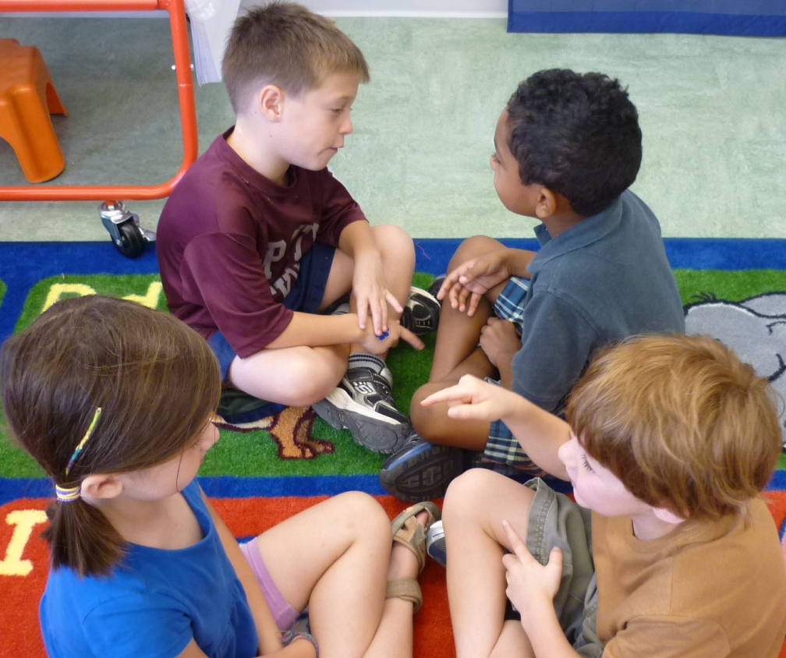
Talk Partners
Pupil talk is central to active learning. Establishing talk partners is often the first step teachers take in experimenting with formative assessment, as it is relatively straightforward to embark on and the impact can be seen immediately.’
Shirley Clarke 2008
Notes:
Using Talk Partners ensures quality talk in the classroom.
The main change in the classroom is who is doing the talking.
Traditional classrooms is teacher talking to class or individuals and often many teachers usually have a question and response session as part of their lessons; whilst this provides opportunity for individual children to respond using ‘talk partners’ means that there is no opportunity for children to opt out while the confident few so most of the talking and thinking.
Many of us are guilty of asking a question and waiting for the children to think and answer through raising their hands, however my research has shown that it is the same few children who are always first with their hands up and do most of the answering, therefore most of the class opt out of listening and thinking as a consequence.
I have therefore introduced within my classroom a no hands up policy.
The use of talk partners means there is a constant handover to the children when questions are asked or tasks are underway. Children are immediately more motivated to work because they are in charge of their own learning.
Some children feel more confident when using talk partners because they don’t feel any pressure as they are part of a paired response and there is time to discuss.
Children begin to give more detailed answers and gradually developing higher- quality talk.

Slide 84
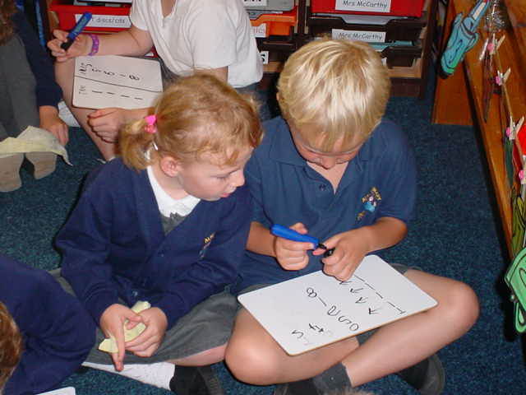
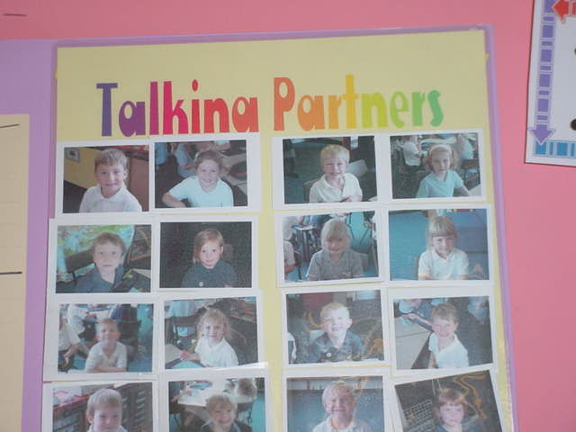
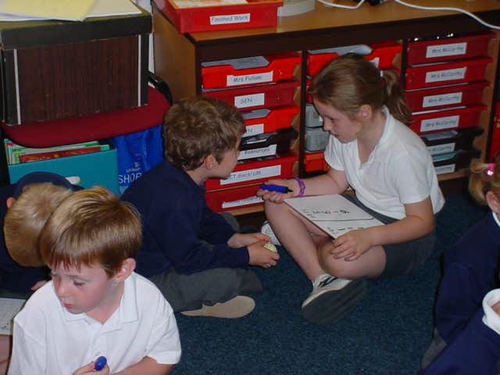
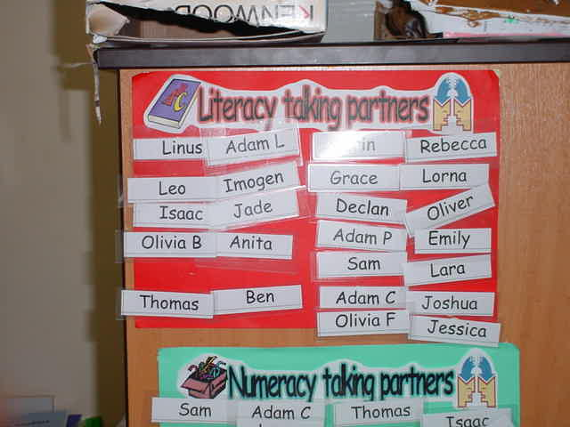
Talk Partners

Slide 85
Talk Partners
Notes:
Greater involvement by all
Less time spent waiting
More opportunities for language development
Reluctant or shy students being involved
More focused learning
Increased interaction between students
More interaction between children and the teacher
More opportunities for creative and exciting discussions

Slide 86
Prerequisites
Children must be able to;
Listen
Be receptive to alternative viewpoints
Think about what they hear
Give others time to think
Notes:
Introducing talk partners does require some preparation and planning.
To engage in meaningful purposeful dialogue children need guidance on:
The courtesies of speaking and listening
Topic appropriate language
How to elaborate on their partners contributions
How to report clearly and succinctly the points discussed
How to stay on task.

Slide 87
This should enable students to:
Narrate
Explain
Instruct
Ask different kinds of questions
Receive, act and build on answers
Analyse and solve problems, speculate and imagine
Explore and evaluate
Argue, reason and justify
Negotiate

Slide 88
What does it look like?
Children listening carefully to each other
Encouraging each other to participate and share ideas
Building on their own and each other’s contributions
Striving to reach common understanding and agreed conclusions
Respecting minority viewpoints

Slide 89
The Importance of Talking Partners
Allows all children to think, articulate and therefore extend their learning
Shy or less confident children have a voice
Over-confident children learn to listen to others
Generates a respectful, co-operative culture
Notes:
No hands up
Most teachers’ lessons begin with automatic question and answer recall session e.g. “Who can remember what plants need to grow?”
The typical response is that the same few children continually have their hands up and, in order to elicit the right answers, the teacher chooses the right children.
Even if an open question is asked, hands shooting up all around while a child is in the process of thinking something through stops that process dead in its tracks.
Many children have had that experience so often that they don’t even begin the thinking process and lose motivation.
Even if the basic recall question (What does a plant need to grow?) a more effective approach than rapid fire is 30 secs to talk – answers gathered, with no hands up from a number of pairs with one child acting as spokesman each time until a full definition is compiled.
We have tended to over-focus on individual children when they have responded to a question, so that child’s name is often repeated, and maybe public congratulations given, creates a comparison effect with those who have not responded.
With talk partners the pair is asked to respond which changes the emphasis from the child to the response
When asking open questions you could get a children to raise their hands if their partner has a good idea that they could tell the class

Slide 90
Talking Partners
Has impact on learning because…
It ensures all children contribute to solving the given problem.
No child is left without a partner and unable to join in.
It removes individual responsibility for an answer, making part answers expected and possible without losing face.

Slide 91
Introducing Talking Partners
Give the children talking partners.
Random….. Friends….. Ability
(Research has shown that random pairings are the most effective)
Wait time
No Hands Up
Notes:
I use Turn and Talk quite a bit when we are doing mini-lesson on the carpet.
I teach/model the process broadly...
I tell them that at Teacher Staff Meetings we are asked to turn and talk to a neighbor and my neighbor may not be same person every time, so I have to know how to do it correctly with anyone.
Once the kids hear that story and we model it whole class and then with any partner (we also go over potential issues -- such as how to engage someone who is not talking, which side to talk to, what to do if there is an uneven number of people)-- they are ready to Turn and Talk to anyone who is sitting next to them....
They are even really good about turning and talking to adults that are volunteering and/or ed techs that join our mini-lesson circle...
Consider and identify opportunities for use of talk partners at the planning stage of your lesson.
Consider the dynamics of the class and think about how you will pair the students.
Photo flip
Knife and fork
Deck of cards
Choose a system that is considered fair by the students
Build up talk partner skills in small steps
Be prepared for the unexpected

Slide 92
Picking Partners
Pick Partners for the children to begin with and until children are comfortable with working in this way.
Generally use ability pairings in Literacy and Numeracy and mixed in foundation subjects.
Do what works best for you!
Notes:
Why Random talk partners?
Random talk partners has proven the best way and should be changed either weekly or fortnightly.
This constant change means that children appreciate the fairness factor and gain from a variety of social and learning experiences they encounter;
Share learning with different children and not just the same group;
Avoids the use of ability groups – boosts confidence of lower achieving children;
Can be used at any time in any lesson;
They get to hear and share opinions;
Make new friends and get to know other people in their class;
Fun and supporting – if children need help they can ask their partner rather than their teacher. Children can sometimes be nervous about asking the teacher because they have to admit they don’t know. This also means we are developing independent learners.
Children can later pick partners at random by taking a name out of a hat etc.
Talk partners are chosen each week. Photographs on playing cards. A random shuffling of cards takes place and then the top card is turned over and shown to the children. The next card is turned over and they are paired together. [The children decided that if they have been paired, during the previous term, then the second card [person] would be replaced within the pack of cards and a new partner would be turned over.]

Slide 93
Talking Partners cont.
Take a photo of each child. Place the photos in a box and draw out pairs randomly. Place photos in pairs on a display board.
Complete ‘compliment slips’ before students change partners.
Share the rationale with students. Spend time modelling and explaining talk partners at the beginning.
Notes:
On Monday have a “meeting moment” where they first say goodbye to their old partner by shaking their hand and saying something positive. They then go and sit with their new partner and have an some sort of ice breaker activity together.
They are written for their partner and given to them as they part company. “Thanks for being a great talk partner. I really enjoyed learning with you because….
Remember this is all happening in a ‘no hands up’ classroom. Talk about how they might feel if they were partnered with someone they were not happy with and how they might cope with that. There is great potential for team building and using pairs into four to solve a problem.

Slide 94
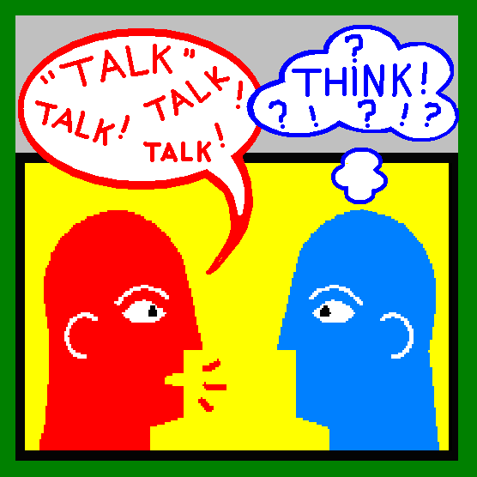
Talking Partners
Partners need to change regularly so that children experience different people’s ideas and personalities.
The selection of a partner tends to be choose a paddle pop stick out of a tin on Friday.
Ensure, at the start of the lesson, that everyone knows who they will be talking to.
Check pairs for each lesson/day
Create Class ground rules
Magic spots
Notes:
Model speaking courtesies
Model the vocabulary to be used
Model Questioning, Good and Bad Talking/ Listening
Model responding
Initially, I introduced the concept to the class, explaining how the talk partners system would work and the rules that must be observed – e.g. sit knee to knee, listen, respond, take turns, share ideas and so on.
We had a circle time discussion based around why it is important to talk about and share their learning with each other. I asked the children to think about what would happen if they didn’t share their learning with anyone.
Next, I modelled the strategy using my teaching assistant.
We modelled being bad talk partners and the children shared their ideas as to how we could do it properly.
Using this modelling process and the children’s idea success criteria was generated with the children agreeing a set of rules regarding respectful speaking and listening.
These are displayed in the classroom as a reminder.
The idea of random talk partners was introduced and I shared the random name generator programme with the children.
They really liked this programme and the fairness factor, they like that it is completely out of my control.
There had been some issues at first with children not wanting to sit with certain children but they really like the system now and want to sit with their friends less than before.
At the beginning of each week, I use the random name generator to identify pairings.
The children choose which table and where in the classroom they want to sit.
At the end of the week the children are given an evaluation in which they complete to determine whether they have been a good talk partner and whether their partner was a good partner.
I choose which pair I feel has worked the best and followed the success criteria and gained the most benefit from having each other as a learning partner. This pair is stood up in golden assembly and each child receives a certificate.
At the start of different lessons, either problems were set or questions asked for the talk partners to work through and the pupils were encouraged to share their thoughts and knowledge with their partner to explain how they could solve the problem.
Sometimes the children are asked to whiteboards to make jottings and notes to help refine their thinking.
Whilst this is happening, depending on the length of the time given I walk around the classroom listening to children’s talk and identifying any misconceptions on the spot, giving immediate feedback.
I find this useful for both APP and evaluating the children’s speaking and listening skills.
As the pairs are random the children have opportunities over the weeks to work with peers who had different learning styles and ways of thinking to themselves.
A significant advantage in using this approach is that children never have to wait in a whole class ‘hands up’ situation – they always have an opportunity to share their thoughts and ideas.
I would ask the question or set the problem and then give the children their ‘talk’ time before using the programme to decide who will answer the question. This is often open to the pair rather than the individual.
I have found that as a pair they support each other in their answering and enabling me to gain higher ordering thinking/ questioning. It has also made it very difficult for children to ‘switch off’ during this part of the lesson, as their talk partner was depending on their interaction and the children always had the sense ‘it could be me.’
I use talk partners in a variety of lessons and have found it particularly effective in literacy, numeracy, science, P.S.H.E. and PE. Alongside talk partners we also use the ‘ask-it’ baskets.
Even if the question is a basic recall question a more effective approach than rapid fire is to ask the question, then ask children to talk to their talking partner for say 30 seconds, to determine the answer.
The answers are then gathered, with no hands up, from a number of pairs ( with one child acting as a spokesperson each time) until a full definition is compiled.
If an open ended question is asked it is often useful to ask students to raise their hands if their PARTNER had a good idea that they could tell the classs.
Having talking partners as a regular feature of the lesson allows all students to think, articulate and extend their learning.
Shy, less confident students have a voice and overconfident students have to learn to listen to others.

Slide 95
Rules Developed by Year 6
Don't be afraid to speak up and give your opinion.
Share your ideas with other people.
Try to stay focused on the question or problem and not get distracted.
Be polite and listen to your partners ideas.
Two combined ideas are often better than two separate ones.
Look at your partner when they are speaking, don't be rude.
Take turns in listening and speaking, don't interrupt.
Be prepared to admit that other people's ideas might be better than yours.
Notes:
It is important that the teacher establishes and maintains the ground rules for the talk partner sessions.
This seems to work best when children are involved in putting the groups rules together
They are displayed and referred to by the teacher regularly with feedback given to children who keep to them without reminders
You have been given some handouts on how to be a successful talk partner with some ideas on what not to do
Display these and refer to them regularly
What happens if they end up with the same pair?
If a pair is chosen at random whom sat together the previous week then as a class we decided that their names would be put back in, however it is evitable that children will end up together again and if it wasn’t the previous week then they will be partners again. The idea is that they build on the feedback given last time and continue to develop at being good learning partners.

Slide 96
Notes:
Children need to have thinking time to answer a question, but discussing with a talk partner during that time or using mini whiteboards makes the thinking time more productive.
Talk Partner discussion needs to be very focussed and not too long. e.g. 30 seconds to come up with one thing you can see in this writing;
One minute to think of a good simile for a cat;
Two minutes to decide what has gone wrong with this calculation.
This avoids pupils losing momentum and going off task.

Slide 97
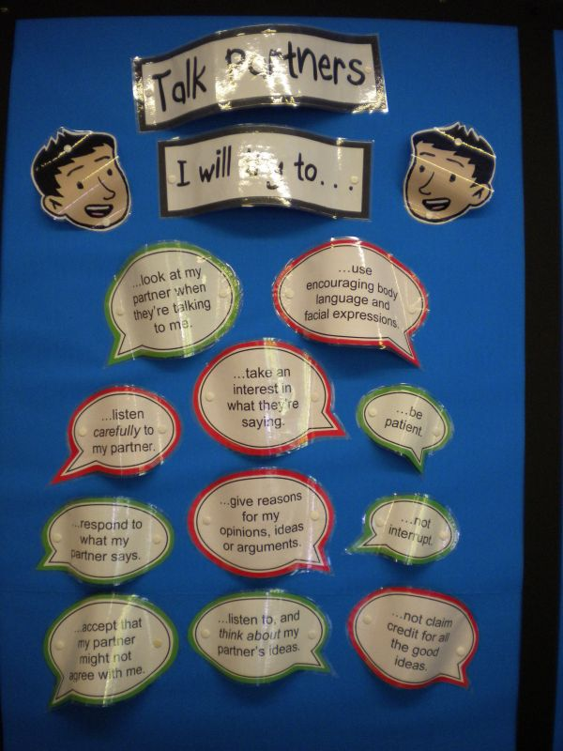
How to be a successful Talking Partner
Sit knee to knee
Look at your partner when they are talking
Look interested
Let your partner express his or her views
Say more than one or two words
Be prepared to compromise
Respect the views of other people

Slide 98
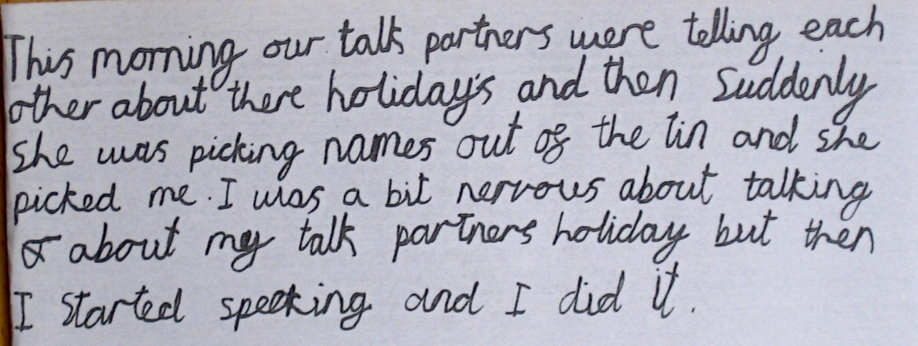
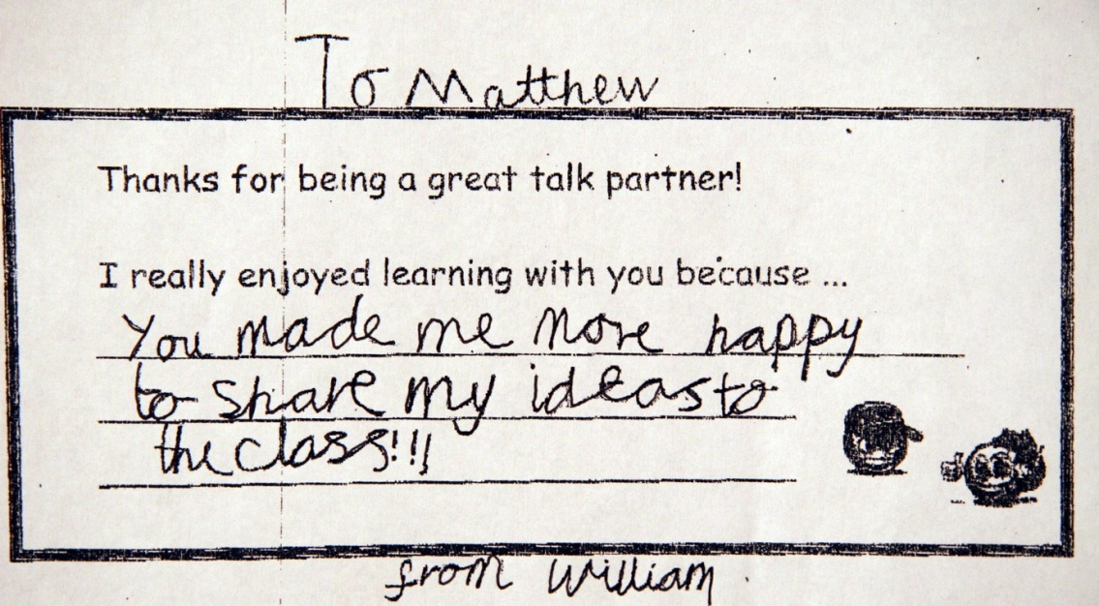
Talk Partners

Slide 99
Read, Write and Talk

Slide 100
Talk Partners
As a plenary or a starter referring to
the last lesson, pupils share with a
partner:
3 new things they have learnt
What they found easy
What they found difficult
Something they would like to learn in the future

Slide 101
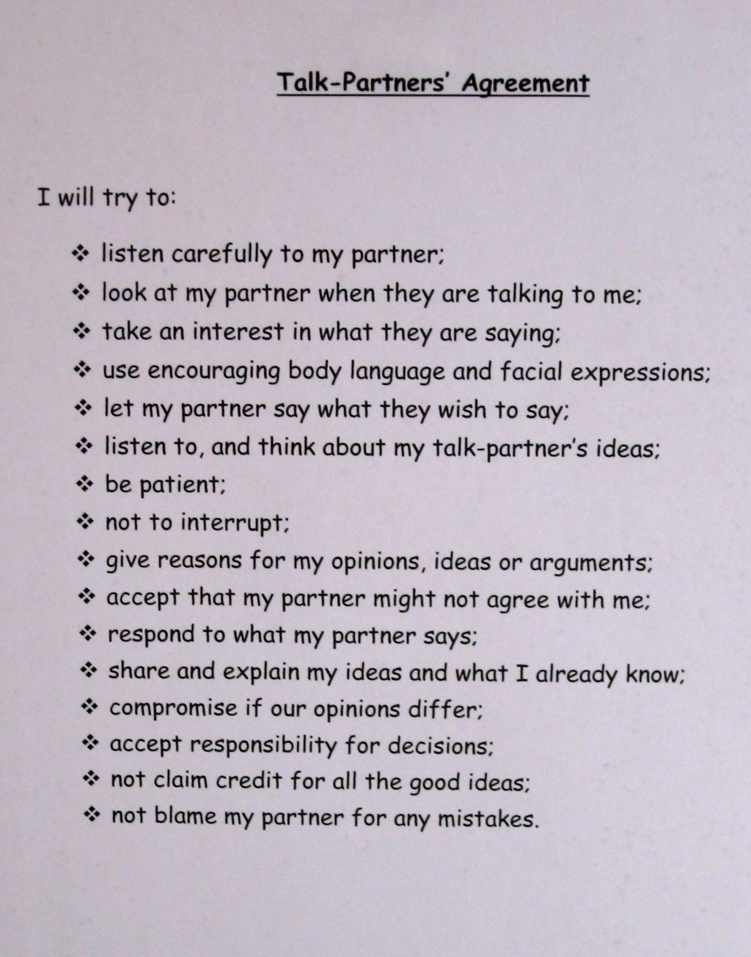
“Talk partners have widened children’s social understanding and increased their tolerance of other people.”

Slide 102
Display

Slide 103
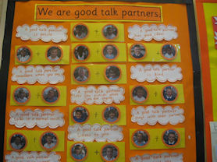
Display

Slide 104
Unwilling Children
If any children seem unwilling to talk to their partner try pairing them with a friend for a short time until they become more confident.
Notes:
Some children will still find it difficult to work in this way and may need more guidance.
Try role playing the activity with another member of staff in the room.
Ask pairs of children who are having difficulty prompt questions. In this way you are modelling a good partner.
Try recording the children!
There may be times when you want the children to make notes of what they are discussing. Using whiteboards will allow the children to quickly change anything as their thoughts develop.

Slide 105
What the children think
“It’s exciting because you get to share.”
“I like having someone to check my work before I show it to my teacher.”
“It’s nice being allowed to chat to the person next to you.”
“You learn from your partner.”
“You have to explain to your partner.”
Notes:
We changed talk partners once a week on a Monday and it was always the highlight of the lesson!
On the Friday they would write a short evaluation of their talk partner and then on the Monday the new talk partner would read the most recent evaluation to get a feel of what their talk partner was like.
I always had talk partners sitting next to each other on the carpet for main teaching using whiteboards when needed and then for written work they would also go and sit with their talk partners
Key to AfL is students being active,
engaged participants in their learning.
Think of ways in which content can be
manipulated for these ends, rather
than the other way round.
If the content seems boring then
make the approach fun or interesting.

Slide 106
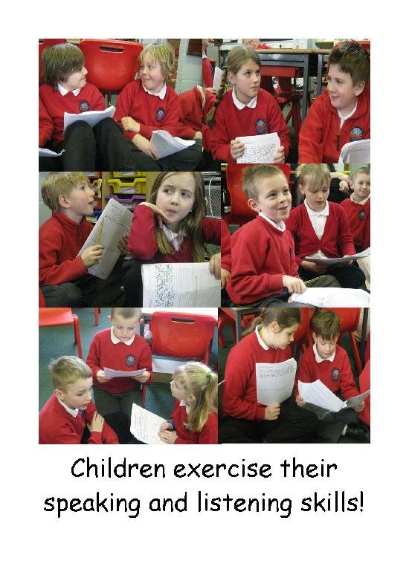
Notes:
Creating a supportive climate
Gather responses
(Does anyone agree, disagree, want to add more?)
Stall
(Hold that thought. Come back later if you have any different ideas)
Make a suggestion or offer information
(It might be useful to…)
Aim for ‘pass’ as acceptable: avoid recall questions

Slide 107
Effective Questioning
In order for talking partners to be successful, you need a question that requires discussion.
“More effort has to be spent in framing questions that are worth asking, that is, questions that are critical to the development of student understanding.”
Black et al 2003
Notes:
Framing the questions
Some Strategies:
a range of answers
a statement
right and wrong
starting from the end
an opposing standpoint

Slide 108
Ground Rules for Respectful Talk
Students listen to each other with respect and courtesy.
No name calling or remarks ever allowed.
It is okay to disagree.
Establish clear consequences for violation of these rules.
Establish conditions for full participation:
Every student needs to listen to what others say.
Every student can hear what others say
Every student may participate by speaking out at some point.
Notes:
Practice one or two talk moves to begin. Perhaps revoicing and wait time.
Assure kids that talk moves will help them become better thinkers and listeners.
Thinking about what we are learning in maths can help us all understand the big idea better.
We can all learn new ways of thinking from listening to how others think.
Talking about our thinking can help us to clarify our thoughts.
If we try to communicate clearly our thinking may get better as a result of our efforts.
So
Treat each other civilly at all times.
Participate in the class discussion
Speak loudly enough for others to hear
Respect a speakers idea
Explain why you agree or disagree with a speakers idea

Slide 109
Ground Rules for Respectful Talk
Hear the speaker
Listen and try to understand
Ask questions when we don’t understand
Speaker needs to try hard to be clear
Everyone has a right to participate
Notes:
What does it take for us to understand another person’s thinking. Read five points above.
What might keep a person from participating. Brainstorm with students.
Use partner talk. This allows students to practice their ideas-to put them into words-before they face the class.
It allows students to hear how one other student is thinking about the concept and builds confidence.

Slide 110
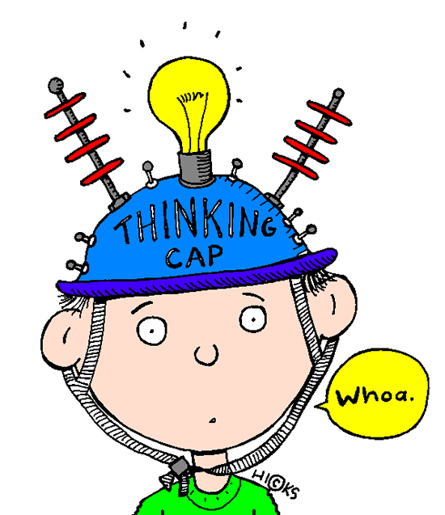
What Mathematics Should We Talk About?
Mathematical symbols, vocabulary and terms
Mathematical reasoning
Induction/ deduction
justification
Notes:
Our goal as teachers is to hold a classroom discussion in which students can reason together about important mathematical issues.
If students are clarifying and sharing their reasoning and listening to one another, but their talk is superficial and their reasoning is shallow we will not achieve the student learning gains we are aiming for.

Slide 111
Practical Ideas
ABCDE Cards
Mini whiteboards
Thinking Thumbs
Fist to Five
Exit Passes
Randomisation
Notes:
Example Technique 1: ABCDE cards. The teacher asks or presents a multiple-choice question and then asks students to simultaneously (on the count of three) hold up one or more cards, labelled A, B, C, D, or E, as their individual response.
ABCDE cards can be cheaply made on 4-inch by 6-inch white cardstock printed with one black, bold-print letter per card. A full set might include the letters A–H plus T.
This format allows all students to select not only one correct answer, but multiple correct answers or to answer true/false questions.
This is an example of an all-class response system that helps the teacher to quickly get a sense of what students know or understand while engaging all students in the class.
The teacher may choose to ask the question orally or to present it to the class on an overhead.
The teacher then uses the information in the student responses to adapt and organize the ensuing discussion or lesson. Once the teacher knows where learners are in their learning she/ he is in a position to provide feedback to the learners about what to do next...and that leads to effective teacher feedback.
.
One technique in this category involves the use of wipe-on, wipe off markers on homemade whiteboards.
Every student has such a whiteboard, and holds it up to show answers to questions asked by the teacher.
This requires every student in the class to show his or her thinking, not just the students in the front row who always raise their hands.
The most important factor influencing learning is what the learner already knows and that the job of the teacher is to ascertain this and to teach accordingly.
Having planned their oral questions, the teachers end by determining how they will monitor students’ progress toward achieving the learning goals. They use an Exit Card strategy. Exit cards are written student responses to questions posed at the end of a class or learning activity. Students put their names on cards and respond to a question(s) given by the teacher. They give the card to the teacher before they leave the classroom. Exit cards help teachers determine the readiness of their students for learning a new concept and/or serve as a check for understanding

Slide 112
Our goal is not to increase the amount of talk in our classrooms
but to increase the amount of high quality talk in our classrooms-the mathematical productive talk.

